Slide 1

SCS1501 - OPERATING SYSTEM
UNIT – 2
PROCESS MANAGEMENT
Mrs. C.Kavitha
ASSISTANT PROFESSOR
DEPARTMENT OF CSE
SCHOOL OF COMPUTING

Slide 2


SYLLUBUS

Slide 3
COURSE OUTCOMES
SCS1501.1 | Understand the fundamental components of a computer operating system and how computing resources are managed by the operating system
SCS1501.2 | Apply the concepts of CPU scheduling, synchronization and deadlocks in real computing problems
SCS1501.3 | Demonstrate the different memory and I/O management techniques used in Operating systems.
SCS1501.4 | Have practical exposure to the concepts of semaphores and monitors for process synchronization
SCS1501.5 | Create design and construct the following OS components: Schedulers, Memory management systems in the modern operating system.
SCS1501.6 | Understand file system structure and implement a file system such as FAT

Slide 4
INTRODUCTION TO PROCESSES
Early computer systems allowed only one program to be executed at a time.
Definition : A process is defined as an entity which represents the basic unit of work to be implemented in the system.
A process is basically a program in execution. The execution of a process must progress in a sequential fashion.
A process will need certain resources—such as CPU time, memory, files, and I/O devices —to accomplish its task.
A process is the unit of work in most systems.

Slide 5

Although traditionally a process contained only a single thread of control as it ran, most modern operating systems now support processes that have multiple threads.
A process is the unit of work in a modern time-sharing system.
The more complex the operating system is, the more it is expected to do on behalf of its users.
Systems consist of a collection of processes:
Operating-system processes execute system code, and
User processes execute user code.

Slide 6
PROCESSES
A process is mainly a program in execution where the execution of a process must progress in a sequential order or based on some priority or algorithms.
In other words, it is an entity that represents the fundamental working that has been assigned to a system.
When a program gets loaded into the memory, it is said to as process. This processing can be categorized into 4 sections. These are:
Heap
Stack
Data
Text

Slide 7
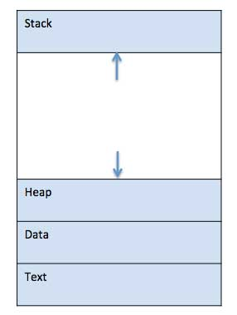
PROCESSES

Slide 8
PROCESSES
Process memory is divided into four sections for efficient working :
Text section is made up of the compiled program code, read in from non-volatile storage when the program is launched.
Data section is made up the global and static variables, allocated and initialized prior to executing the main.
Heap is used for the dynamic memory allocation, and is managed via calls to new, delete, malloc, free, etc.
Stack is used for local variables. Space on the stack is reserved for local variables when they are declared.

Slide 9
What is a Process?
A process is a program in execution.
Process is not as same as program code but a lot more than it.
A process is an 'active' entity as opposed to program which is considered to be a 'passive' entity.
Attributes held by process include hardware state, memory, CPU etc.

Slide 10
PROCESS CONCEPTS
A question that arises in discussing operating systems involves what to call all the CPU activities.
A batch system executes jobs, whereas a time-shared system has user programs, or tasks.
Even on a single-user system such as Microsoft Windows, a user may be able to run several programs at one time: a word processor, a web browser, and an e-mail package.

Slide 11
PROCESS CONCEPTS
Process – a program in execution; process execution must progress in sequential fashion.
A process is a program in execution. A process is more than the program code, which is sometimes known as the text section.
A process includes:
Counter
Program stack
Data section
The current activity, as represented by the value of the program counter and the contents of the processor's registers.
The process stack contains temporary data (such as function parameters, return addresses, and local variables)
A data section, which contains global variables.
Process may also include a heap, which is memory that is dynamically allocated during process run time.

Slide 12
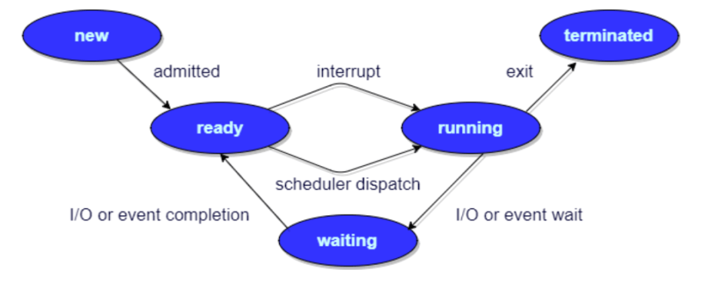
PROCESS STATE / PROCESS LIFE CYCLE

Slide 13
PROCESS STATE
When a process executes, it passes through different states.
These stages may differ in different operating systems, and the names of these states are also not standardized.
In general, a process can have one of the following five states at a time.
New/Start
Running
Waiting
Ready
Terminated

Slide 14
PROCESS STATE
START / NEW
This is the initial state when a process is first started / created.
READY
The process is waiting to be assigned to a processor.
Ready processes are waiting to have the processor allocated to them by the operating system so that they can run.
Process may come into this state after Start state or while running it by but interrupted by the scheduler to assign CPU to some other process.
RUNNING
Once the process has been assigned to a processor by the OS scheduler, the process state is set to running and the processor executes its instructions.

Slide 15
PROCESS STATE
WAITING
Process moves into the waiting state if it needs to wait for a resource, such as waiting for user input, or waiting for a file to become available.
TERMINATED OR EXIT
Once the process finishes its execution, or it is terminated by the operating system, it is moved to the terminated state where it waits to be removed from main memory.
These names are arbitrary, and they vary across operating systems.

Slide 16
PROCESS STATE
NEW- The process is being created.
READY- The process is waiting to be assigned to a processor.
RUNNING- Instructions are being executed.
WAITING- The process is waiting for some event to occur(such as an I/O completion or reception of a signal).
TERMINATED- The process has finished execution.

Slide 17
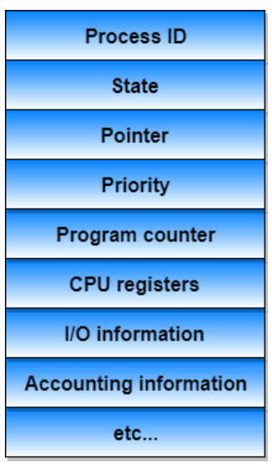
PROCESS CONTROL BLOCK (PCB)

Slide 18
PCB
There is a Process Control Block for each process, enclosing all the information about the process. It is a data structure, which contains the following:
Process State
It can be running, waiting etc.
Process Privileges
This is required to allow/disallow access to system resources.
Process ID
Unique identification for each of the process in the operating system.

Slide 19
PCB
Pointer
A pointer to parent process.
Program Counter
Program Counter is a pointer to the address of the next instruction to be executed for this process.
CPU Registers
Various CPU registers where process need to be stored for execution for running state.
CPU Scheduling Information
Process priority and other scheduling information which is required to schedule the process.

Slide 20
PCB
Memory Management Information
This includes the information of page table, memory limits, Segment table depending on memory used by the operating system.
Accounting Information
This includes the amount of CPU used for process execution, time limits, execution ID etc.
IO Status Information
This includes a list of I/O devices allocated to the process.

Slide 21
PCB
The architecture of a PCB is completely dependent on Operating System and may contain different information in different operating systems. (shown in the diagram)
The PCB is maintained for a process throughout its lifetime, and is deleted once the process terminates.

Slide 22
PROCESS SCHEDULING
The act of determining which process is in the ready state, and should be moved to the running state is known as Process Scheduling.
AIM : The process scheduling system is to keep the CPU busy all the time and to deliver minimum response time for all programs.
For achieving this, the scheduler must apply appropriate rules for swapping processes IN and OUT of CPU

Slide 23
PROCESS SCHEDULING
Scheduling fell into one of the two general categories:
Non Pre-emptive Scheduling: When the currently executing process gives up the CPU voluntarily.
Pre-emptive Scheduling: When the operating system decides to favour another process, pre-empting the currently executing process.

Slide 24
What are Scheduling Queues?
All processes, upon entering into the system, are stored in the Job Queue.
Processes in the Ready state are placed in the Ready Queue.
Processes waiting for a device to become available are placed in Device Queues. There are unique device queues available for each I/O device.
The OS maintains all PCBs in Process Scheduling Queues.
The OS maintains a separate queue for each of the process states and PCBs of all processes in the same execution state are placed in the same queue.

Slide 25
Scheduling Queues?
Once the process is assigned to the CPU and is executing, one of the following several events can occur:
The process could issue an I/O request, and then be placed in the I/O queue.
The process could create a new sub-process and wait for its termination.
The process could be removed forcibly from the CPU, as a result of an interrupt, and be put back in the ready queue.

Slide 26
Scheduling Queues?
Process migration between the various queues:
Job queue
Ready queue
Device queues
JOB QUEUE − This queue keeps all the processes in the system.
READY QUEUE − This queue keeps a set of all processes residing in main memory, ready and waiting to execute. A new process is always put in this queue.
DEVICE QUEUES − The processes which are blocked due to unavailability of an I/O device constitute this queue.

Slide 27
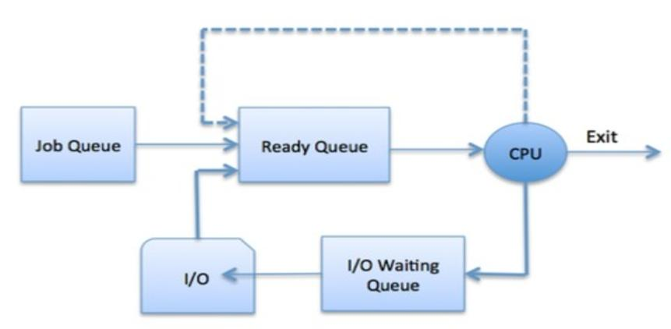
Scheduling Queues?
The OS can use different policies to manage each queue (FIFO, Round Robin, Priority, etc.)

Slide 28
TWO STATE PROCESS MODEL
Two-state process model refers to running and non-running states which are described below
RUNNING
When a new process is created, it enters into the system as in the running state.
NOT RUNNING
Processes that are not running are kept in queue, waiting for their turn to execute. Each entry in the queue is a pointer to a particular process. Queue is implemented by using linked list.

Slide 29
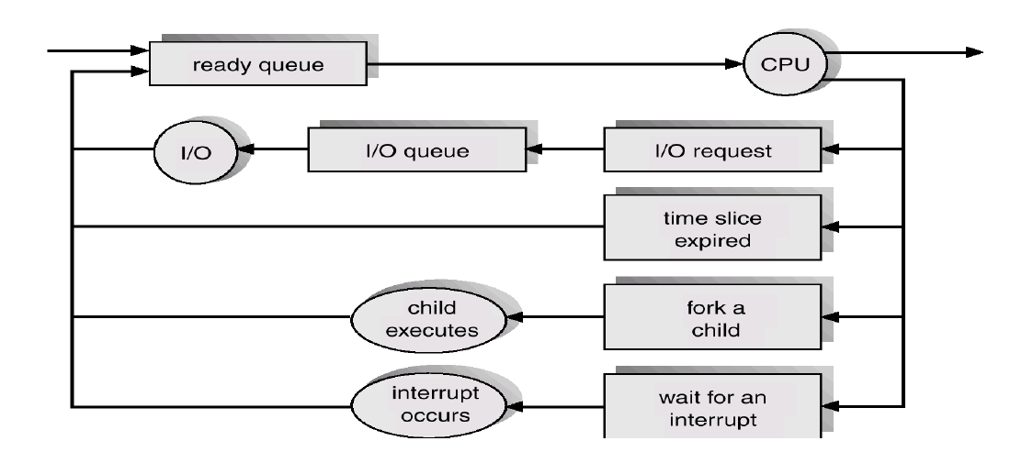
QUEUING DIAGRAM REPRESENTATION FOR PROCESS SCHEDULING

Slide 30
PROCESS SCHEDULING
Each rectangular box represents a queue.
Two types of queues are present:
the ready queue and
a set of device queues
The circles represent the resources that serve the queues, and the arrows indicate the flow of processes in the system.
A new process is initially put in the ready queue.
It waits there until it is selected for execution, or is dispatched.

Slide 31
SCHEDULERS
Schedulers are special system software which handles the process scheduling in various ways.
Their main task is to select the jobs to be submitted into the system and to decide which process to run.
Schedulers are of three types –
Long-Term Scheduler
Short-Term Scheduler
Medium-Term Scheduler

Slide 32
LONG TERM SCHEDULER
It is also called a job scheduler.
A long-term scheduler determines which programs are admitted to the system for processing.
It selects processes from the queue and loads them into memory for execution.
Process loads into the memory for CPU scheduling.

Slide 33
SHORT TERM SCHEDULER
It is also called as CPU scheduler.
Its main objective is to increase system performance in accordance with the chosen set of criteria.
It is the change of ready state to running state of the process.
CPU scheduler selects a process among the processes that are ready to execute and allocates CPU to one of them.
Short-term schedulers, also known as dispatchers, make the decision of which process to execute next.

Slide 34
MEDIUM TERM SCHEDULER
Medium-term scheduling is a part of swapping.
It removes the processes from the memory.
The medium-term scheduler is in-charge of handling the swapped out-processes.
A running process may become suspended if it makes an I/O request.
A suspended process cannot make any progress towards completion.

Slide 35
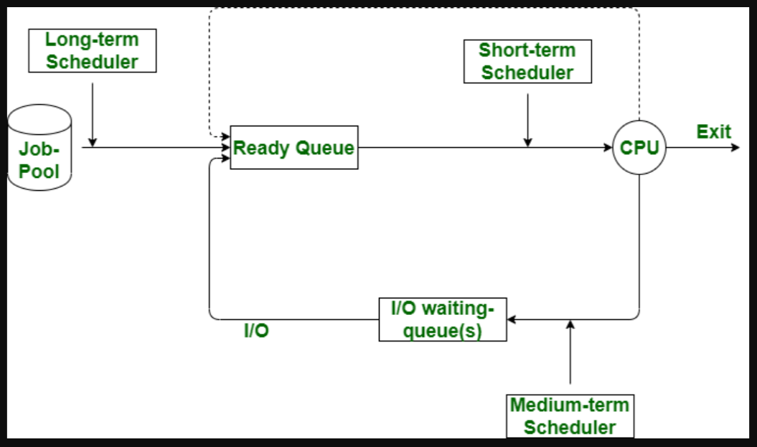

Slide 36
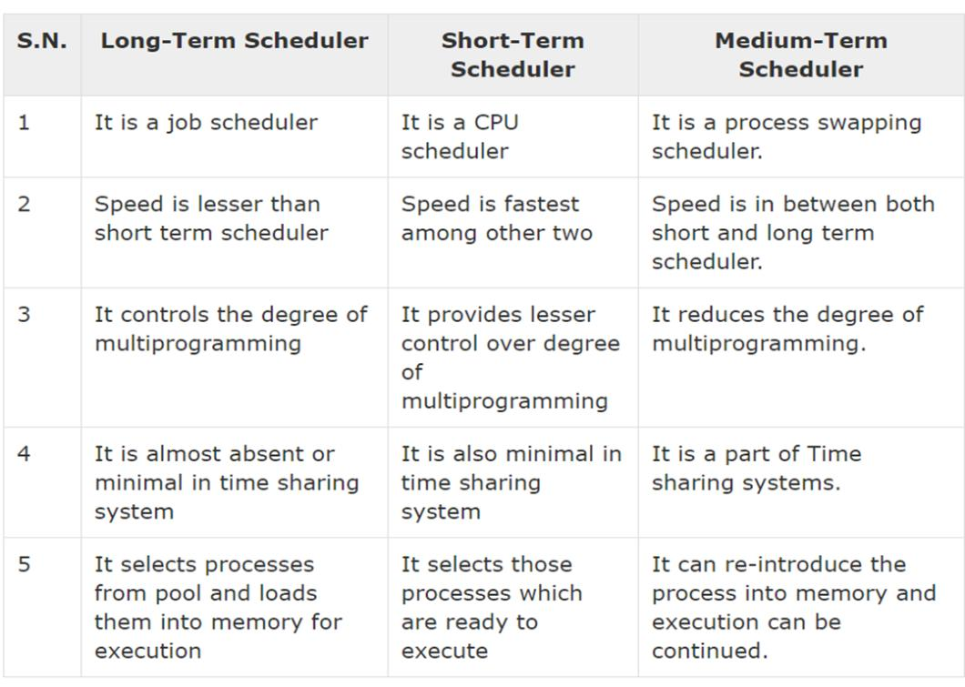

Slide 37
CONTEXT SWITCH
Switching the CPU to another process requires saving the state of the old process and loading the saved state for the new process. This task is known as a Context Switch.
The context of a process is represented in the Process Control Block(PCB) of a process; it includes the value of the CPU registers, the process state and memory-management information.
Context switch time is pure overhead, because the system does no useful work while switching. Its speed varies from machine to machine, depending on the memory speed.

Slide 38
OPERATIONS ON PROCESSES
The processes in the system can execute concurrently, and they must be created and deleted dynamically
The two major operation Process Creation and Process Termination.

Slide 39
PROCESS CREATION
Through appropriate system calls, such as fork or spawn, processes may create other processes.
The process which creates other process, is termed the parent of the other process, while the created sub-process is termed its child.
Parent process creates children processes, which, in turn create other processes, forming a tree of processes.
Resource sharing
Parent and children share all resources.
Children share subset of parent’s resources.
Parent and child share no resources.
Execution
Parent and children execute concurrently.
Parent waits until children terminate.

Slide 40
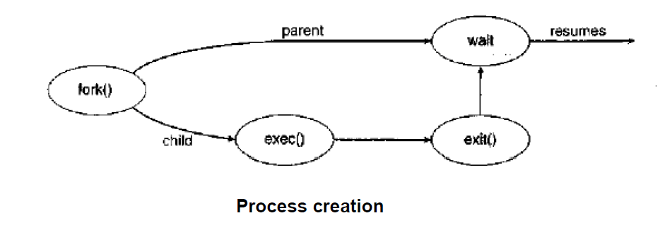
PROCESS CREATION

Slide 41
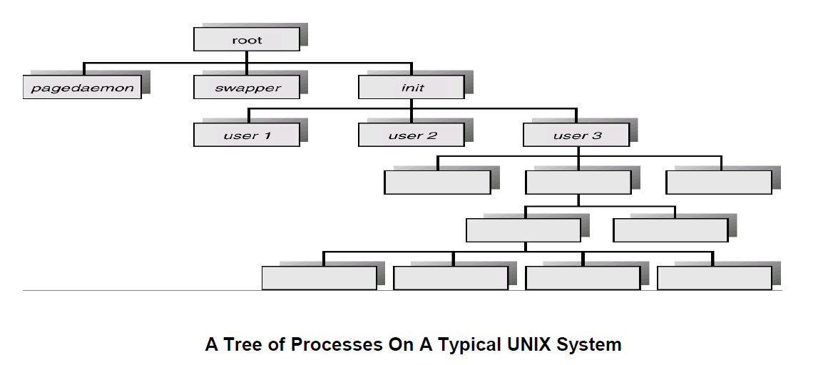
PROCESS CREATION

Slide 42
PROCESS TERMINATION
By making the exit (system call), typically returning an int, processes may request their own termination.
This int is passed along to the parent if it is doing a wait(), and is typically zero on successful completion and some non-zero code in the event of any problem.
Processes may also be terminated by the system for a variety of reasons, including :
The inability of the system to deliver the necessary system resources.
In response to a KILL command or other unhandled process interrupts.

Slide 43
COOPERATING PROCESSES
Processes executing concurrently in the operating system may be either independent processes or cooperating processes.
A process is independent if it cannot affect or be affected by the other processes executing in the system.
Any process that does not share data with any other process is independent.
There are several reasons for providing an environment that allows process cooperation:
INFORMATION SHARING
COMPUTATION SPEEDUP
MODULARITY
CONVENIENCE
BUFFER

Slide 44
COOPERATING PROCESSES
INFORMATION SHARING:
Since several users may be interested in the same piece of information (for instance, a shared file), we must provide an environment to allow concurrent access to such information.
COMPUTATION SPEEDUP:
If we want a particular task to run faster, we must break it into subtasks, each of which will be executing in parallel with the others.
MODULARITY:
We may want to construct the system in a modular fashion, dividing the system functions into separate processes or threads
CONVENIENCE
Even an individual user may work on many tasks at the same time

Slide 45
CPU SCHEDULING
CPU scheduling is a process which allows one process to use the CPU while the execution of another process is on hold(in waiting state)
This is due to unavailability of any resource like I/O etc, thereby making full use of CPU.
The aim of CPU scheduling is to make the system efficient, fast and fair.
The aim of CPU scheduling is to make the system efficient, fast and fair
Whenever the CPU becomes idle, the operating system must select one of the processes in the ready queue to be executed.

Slide 46
CPU SCHEDULING: DISPATCHER
Another component involved in the CPU scheduling function is the Dispatcher.
The dispatcher is the module that gives control of the CPU to the process selected by the short-term scheduler.
This function involves:
Switching context
Switching to user mode
Jumping to the proper location in the user program to restart that program from where it left last time.

Slide 47
CPU SCHEDULING: DISPATCHER
The dispatcher should be as fast as possible, given that it is invoked during every process switch. The time taken by the dispatcher to stop one process and start another process is known as the Dispatch Latency.
Types of CPU Scheduling
When a process switches from the running state to the waiting state (for I/O request or invocation of wait for the termination of one of the child processes).
When a process switches from the running state to the ready state (for example, when an interrupt occurs).
When a process switches from the waiting state to the ready state (for example, completion of I/O).
When a process terminates.

Slide 48
CPU SCHEDULING: SCHEDULING CRITERIA
Different CPU scheduling algorithms have different properties, and the choice of a particular algorithm may favor one class of processes over another.
Many criteria have been suggested for comparing CPU scheduling algorithms.
Which characteristics are used for comparison can make a substantial difference in which algorithm is judged to be best.
CPU UTILIZATION
THROUGHPUT
TURNAROUND TIME
WAITING TIME
LOAD AVERAGE
RESPONSE TIME

Slide 49
CPU SCHEDULING: SCHEDULING CRITERIA
CPU UTILIZATION
We want to keep the CPU as busy as possible.
Conceptually, CPU utilization can range from 0 to 100 percent.
THROUGHPUT
It is the total number of processes completed per unit time or rather say total amount of work done in a unit of time.
TURNAROUND TIME
It is the amount of time taken to execute a particular process, i.e. The interval from time of submission of the process to the time of completion of the process (Wall clock time).

Slide 50
CPU SCHEDULING: SCHEDULING CRITERIA
WAITING TIME
The sum of the periods spent waiting in the ready queue amount of time a process has been waiting in the ready queue to acquire get control on the CPU.
LOAD AVERAGE
It is the average number of processes residing in the ready queue waiting for their turn to get into the CPU.
RESPONSE TIME
Amount of time it takes from when a request was submitted until the first response is produced. Remember, it is the time till the first response and not the completion of process execution (final response).

Slide 51
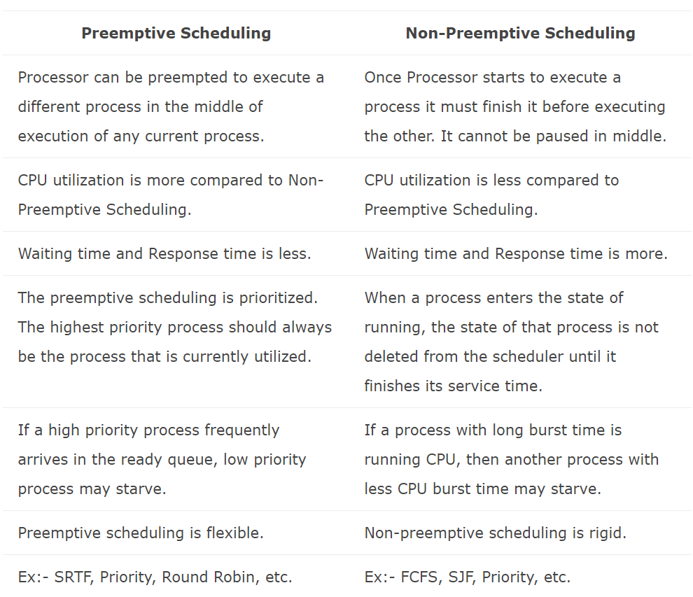
PREEMPTIVE AND NON – PREEMPTIVE

Slide 52
SCHEDULING ALGORITHMS
CPU scheduling deals with the problem of deciding which of the processes in the ready queue is to be allocated the CPU.
There are many different CPU scheduling algorithms:
First Come First Serve (FCFS) Scheduling
Shortest-Job-First (SJF) Scheduling
Priority Scheduling
Shortest Remaining Time (SRT) Scheduling
Round Robin (RR) Scheduling
Multilevel Queue Scheduling
Multilevel Feedback Queue Scheduling

Slide 53
FCFS - FIRST COME FIRST SERVE SCHEDULING
In the "First come first serve" scheduling algorithm, as the name suggests, the process which arrives first, gets executed first
We can say that the process which requests the CPU first, gets the CPU allocated first.
Jobs are executed on first come, first serve basis.
It is a non-preemptive, pre-emptive scheduling algorithm.
Easy to understand and implement.
Its implementation is based on FIFO queue.
Poor in performance as average wait time is high.

Slide 54
SJF – SHORTEST JOB FIRST SCHEDULING
This is also known as shortest job next, or SJN
This is a non-preemptive, pre-emptive scheduling algorithm.
Best approach to minimize waiting time.
Easy to implement in Batch systems where required CPU time is known in advance.
Impossible to implement in interactive systems where required CPU time is not known.
The processer should know in advance how much time process will take.

Slide 55
PRIORITY SCHEDULING
The SJF algorithm is a special case of the general priority scheduling algorithm.
A priority is associated with each process, and the CPU is allocated to the process with the highest priority.
Equal-priority processes are scheduled in FCFS order.
An SJF algorithm is simply a priority algorithm where the priority (p) is the inverse of the (predicted) next CPU burst.
The larger the CPU burst, the lower the priority, and vice versa.
There is no general agreement on whether 0 is the highest or lowest priority.
Some systems use low numbers to represent low priority; others use low numbers for high priority.
Here, we assume that low numbers represent high priority.

Slide 56
ROUND ROBIN SCHEDULING
Round Robin is a CPU scheduling algorithm where each process is assigned a fixed time slot in a cyclic way.
It is pre-emptive as processes are assigned CPU only for a fixed slice of time at most.
The CPU scheduler goes around the ready queue allocating the CPU to each process for a time interval up to some time quantum.
The CPU scheduler picks the process from the ready queue, sets a timer to interrupt after that time quantum and dispatches the process

Slide 57
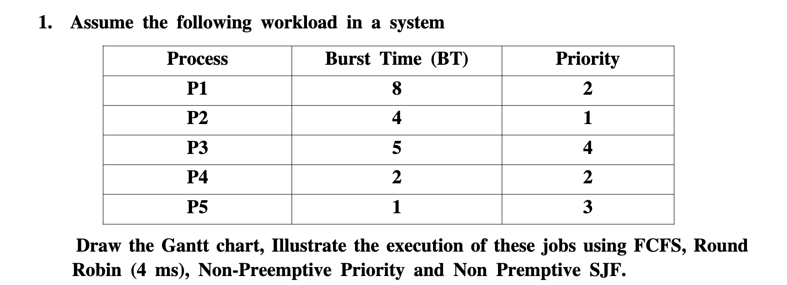

Slide 58
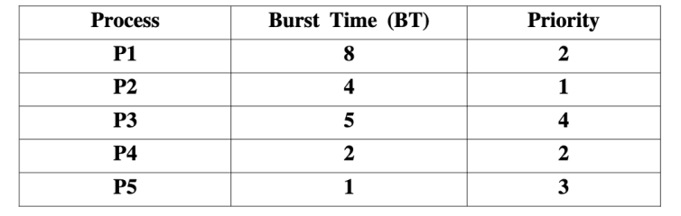
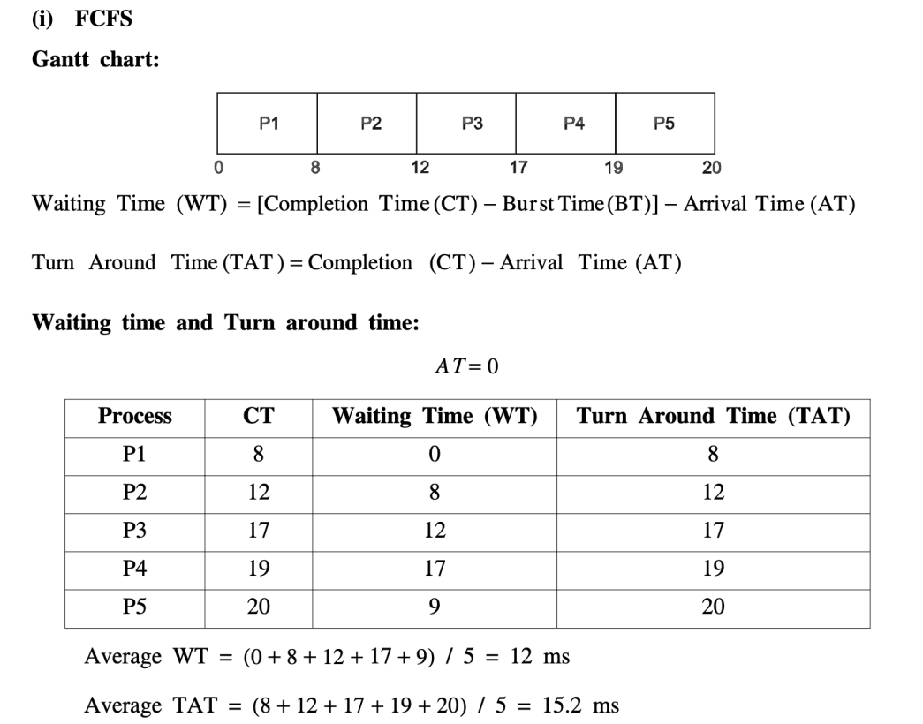

Slide 59
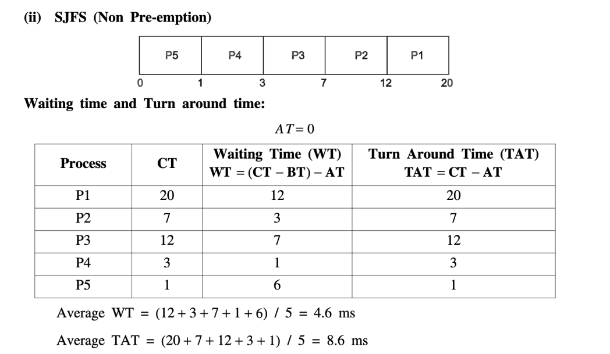

Slide 60
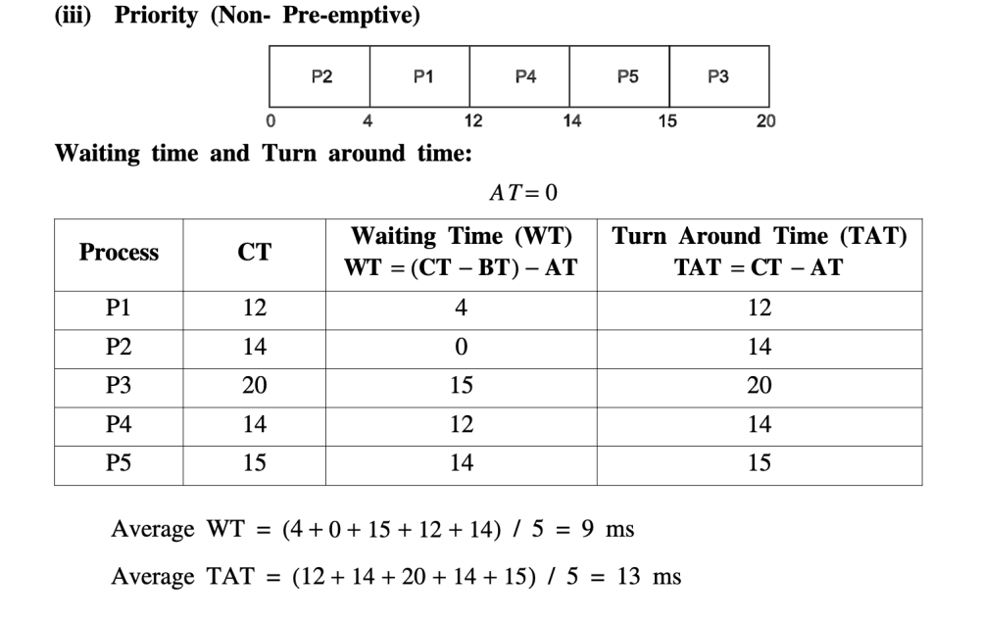

Slide 61
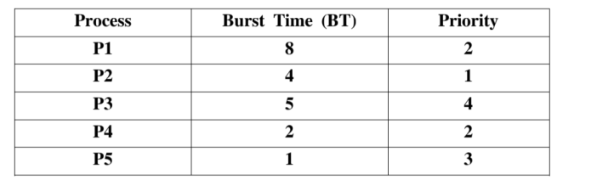
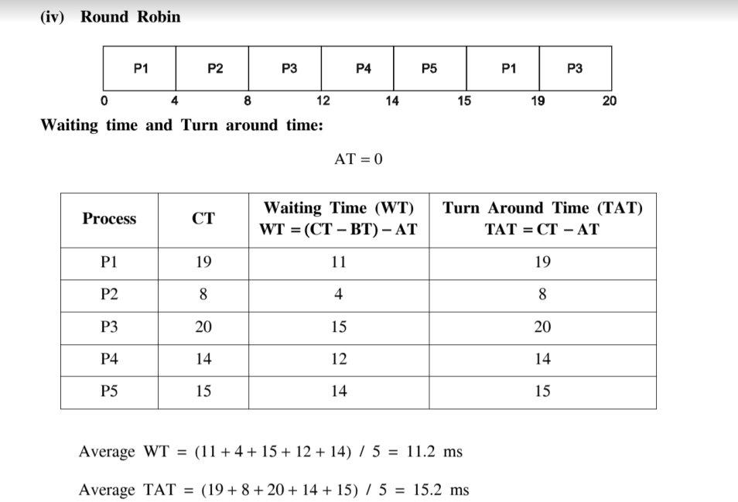

Slide 62
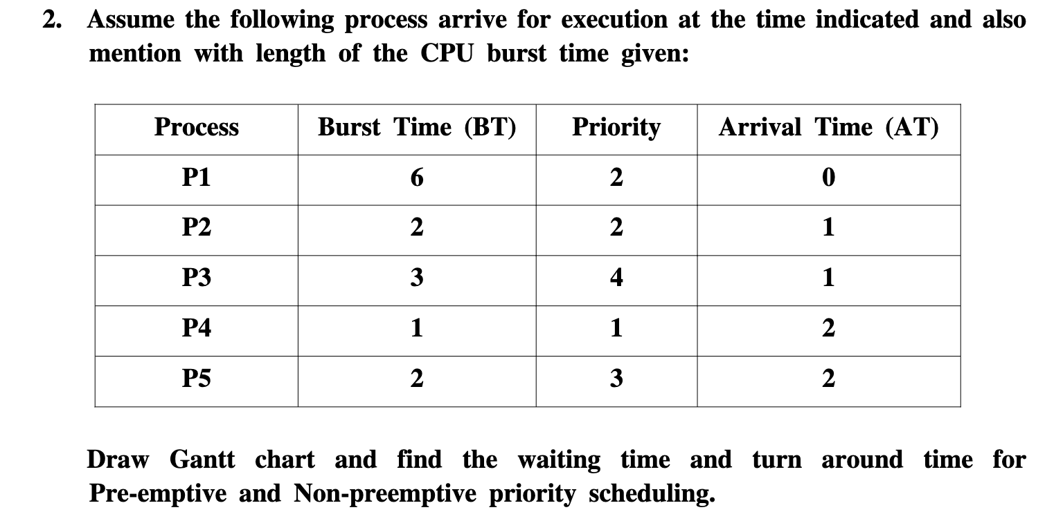

Slide 63
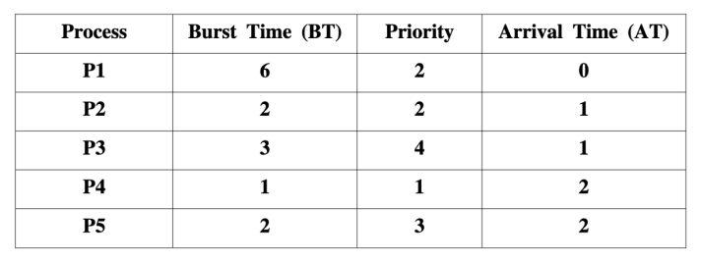
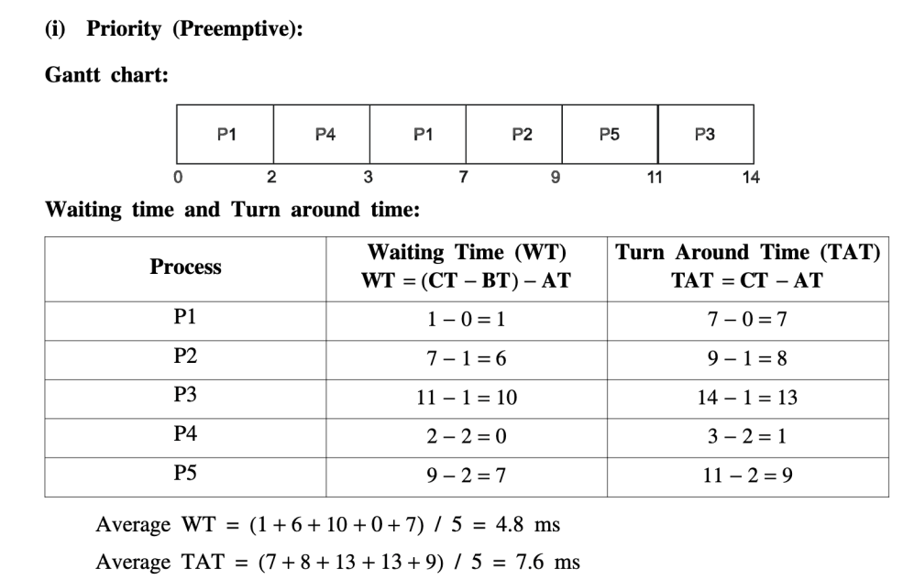

Slide 64
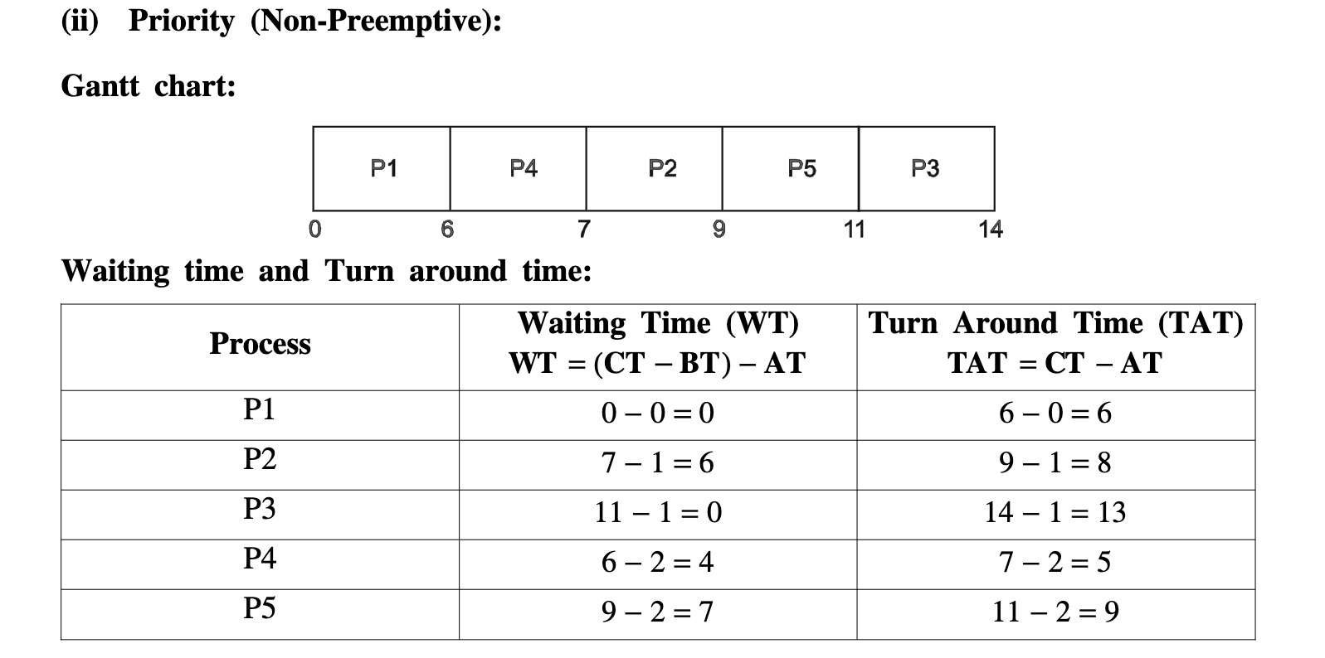

Slide 65
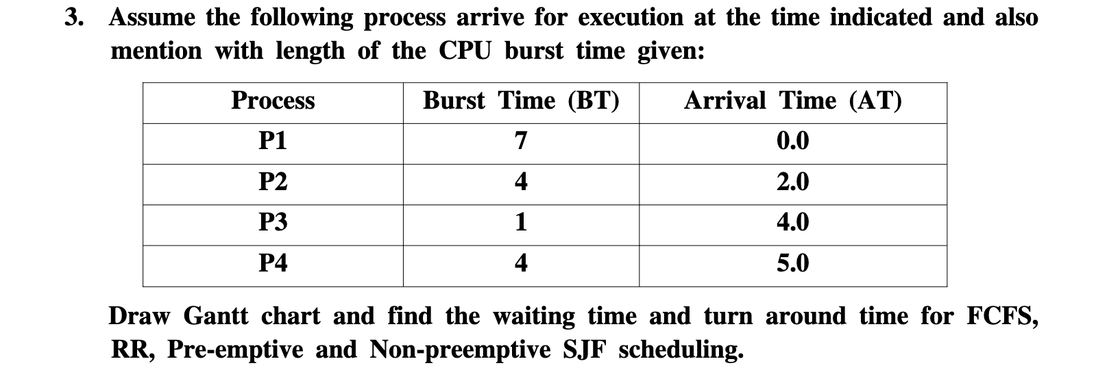

Slide 66
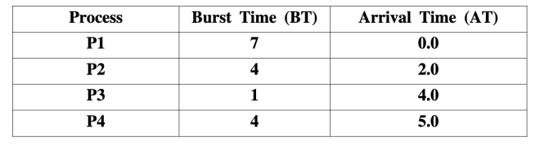
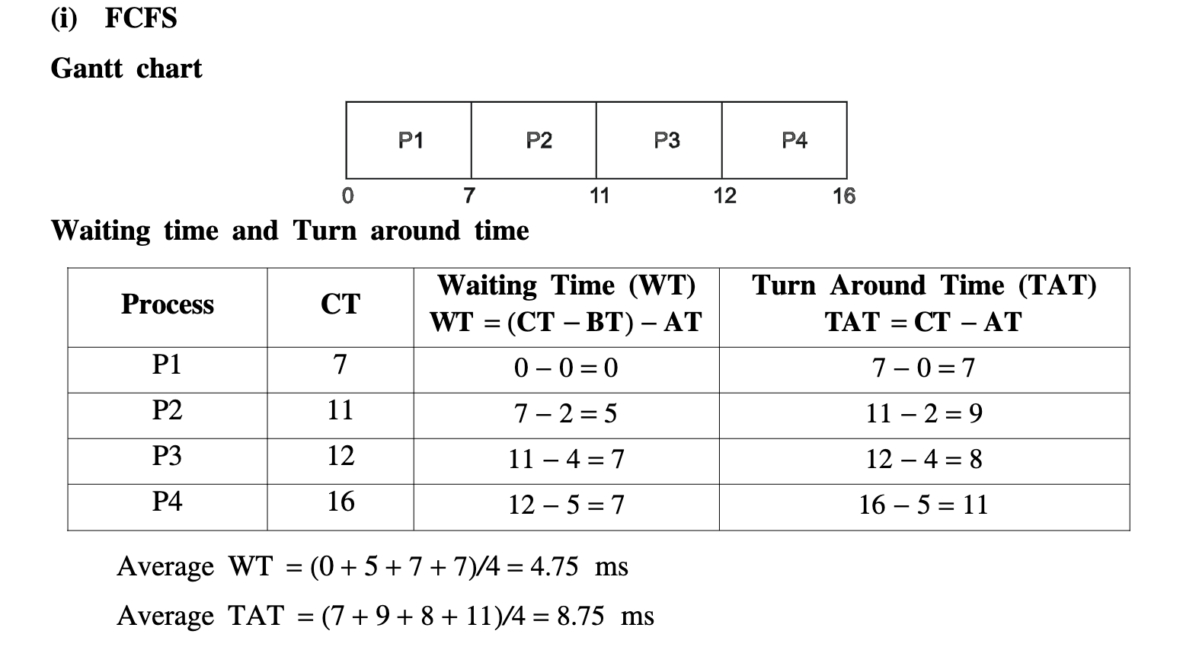

Slide 67
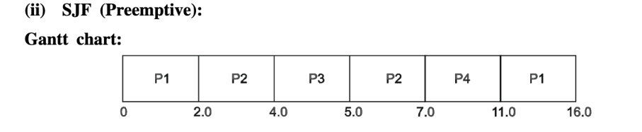
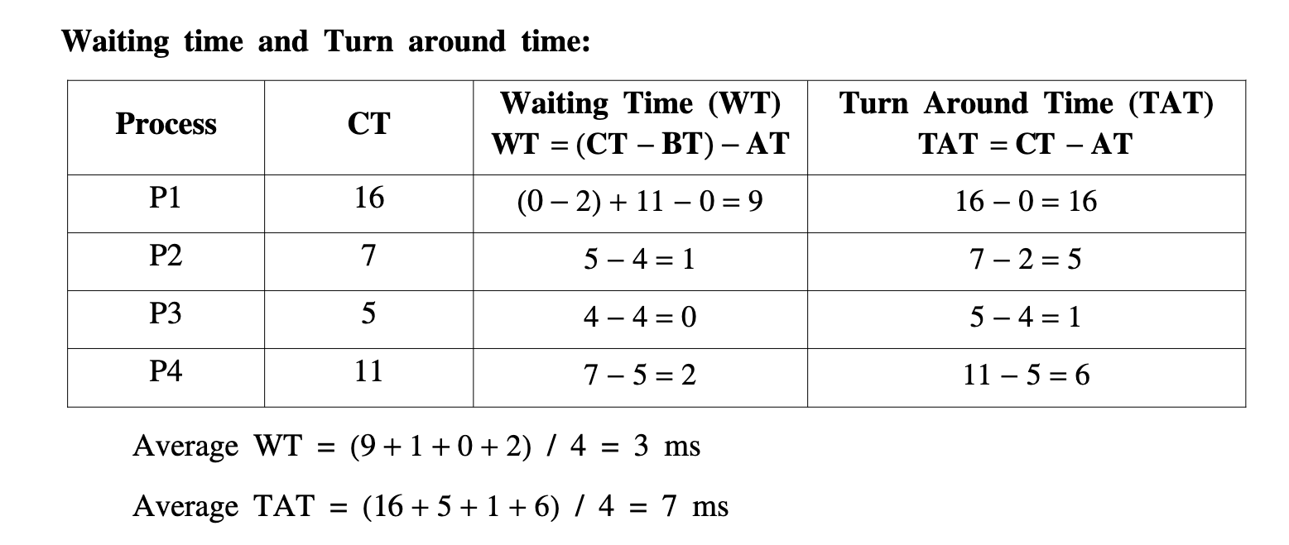

Slide 68
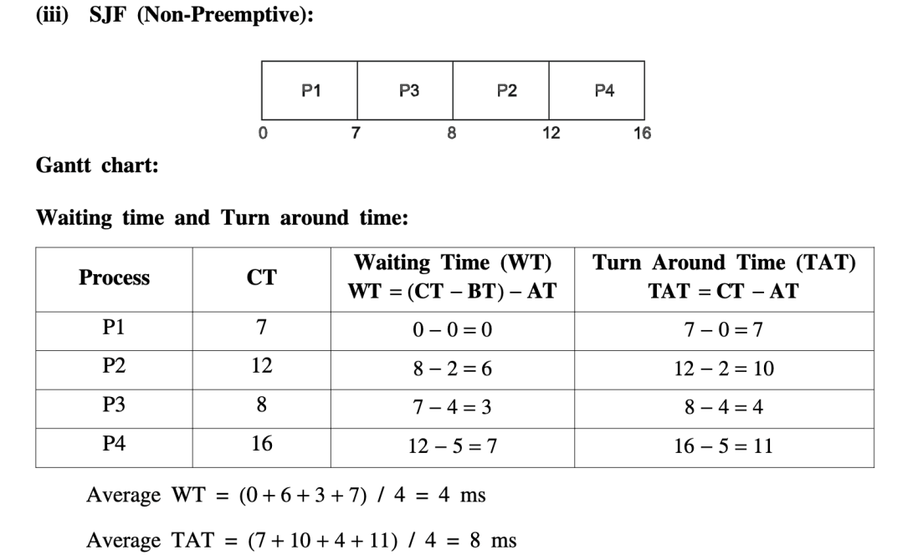

Slide 69
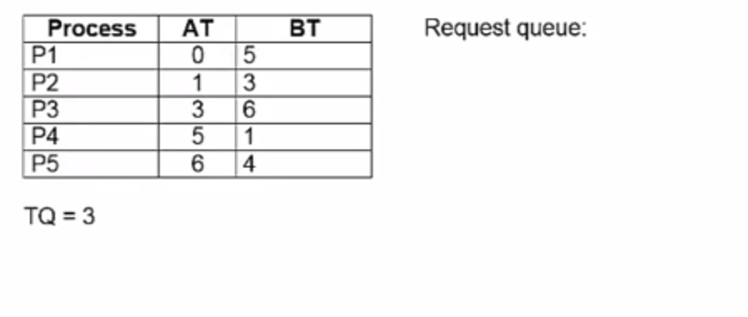
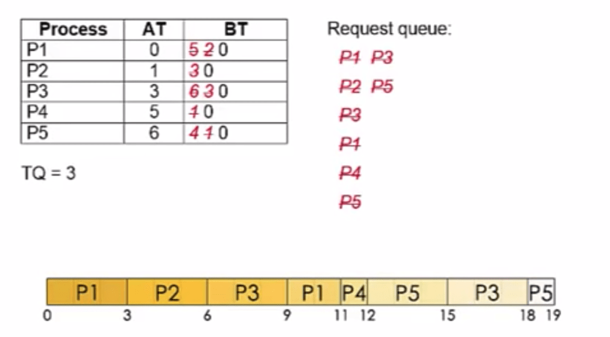
Round Robin

Slide 71
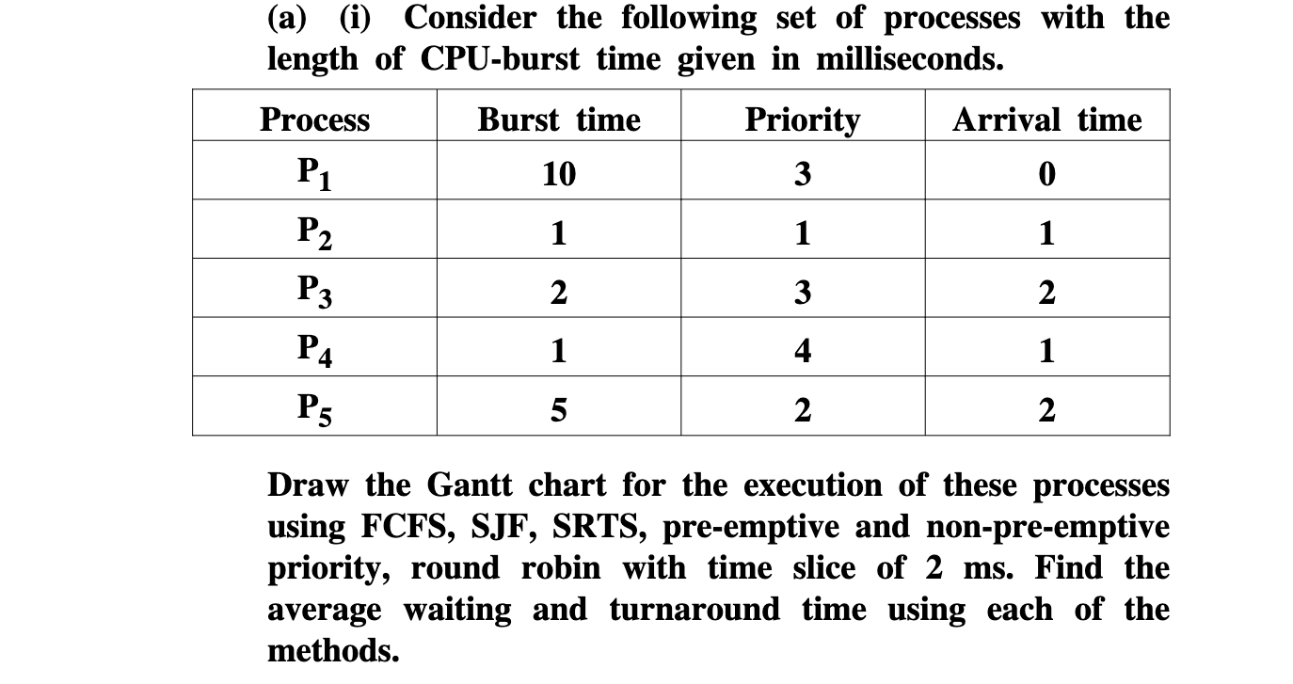

Slide 72
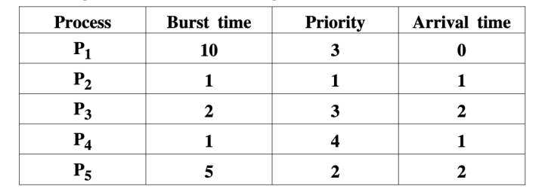
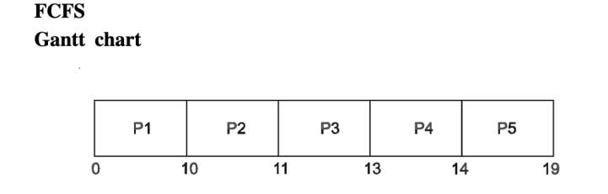
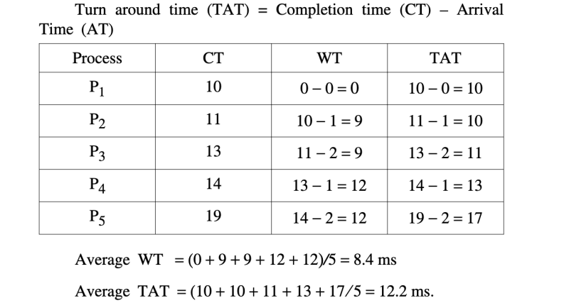

Slide 73
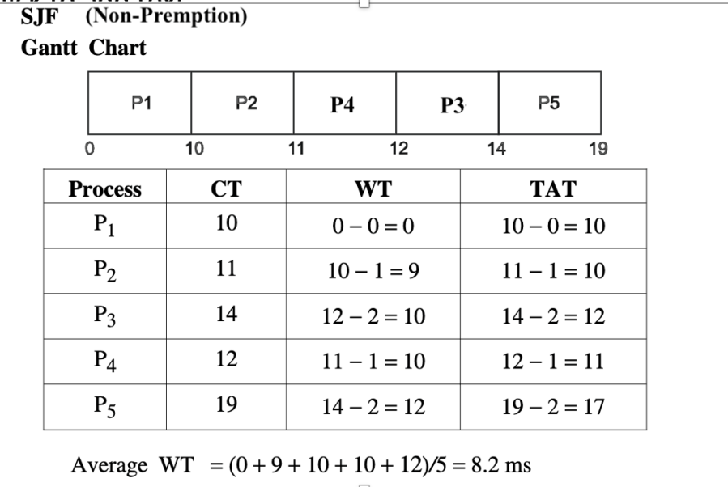

Slide 74
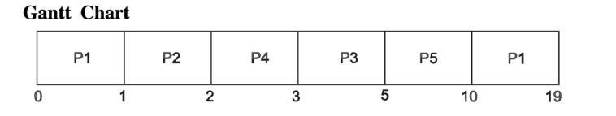
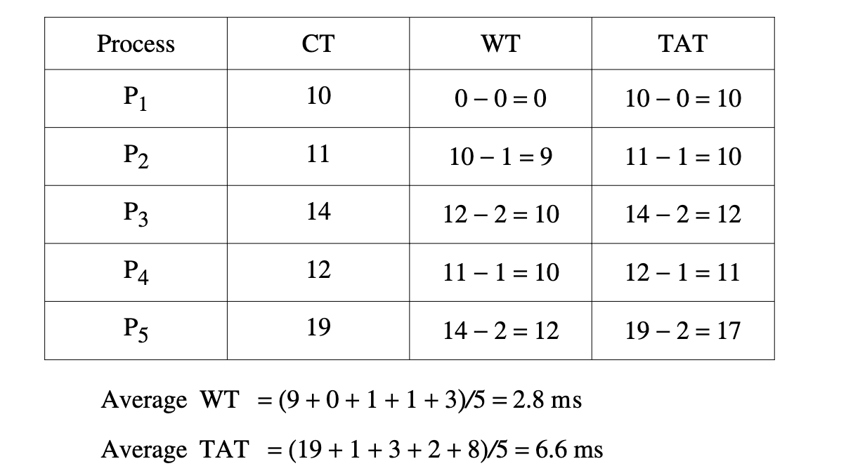
SJF (Pre-emption)

Slide 75
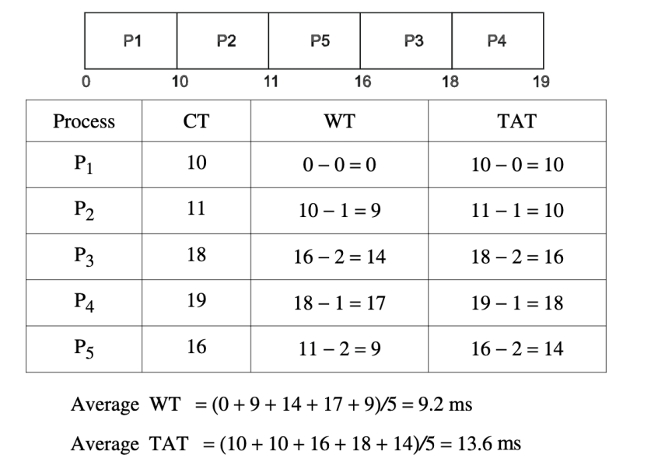
Priority ( Non-Premption)

Slide 76
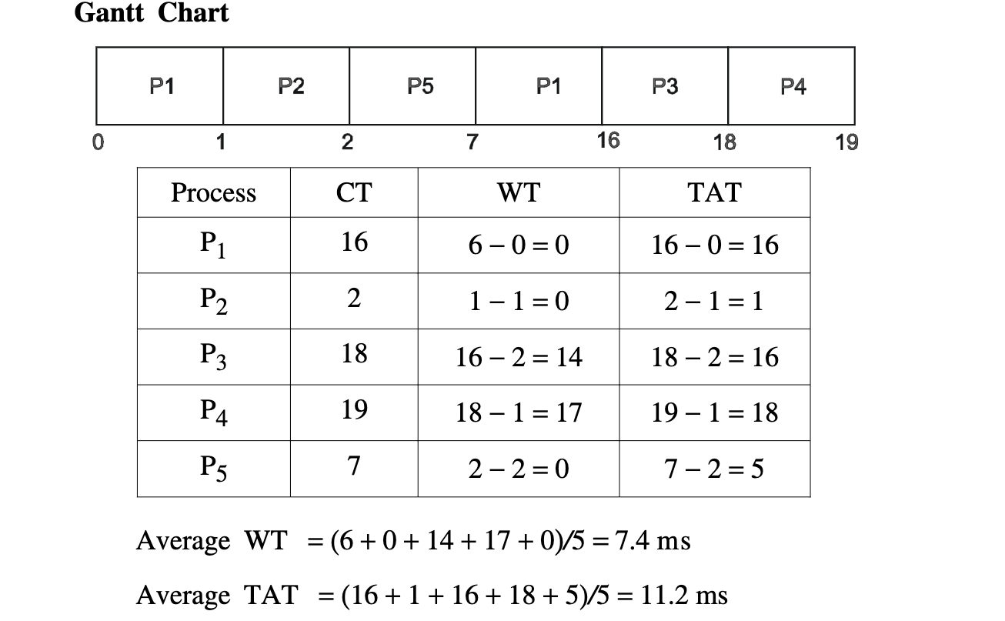
Priority (Pre-emption)

